Slide 1

THE TECHNOLOGY PLATFORM TO TRAIN THE SOLAR WORKFORCE IN THE DEVELOPING WORLD

Slide 2
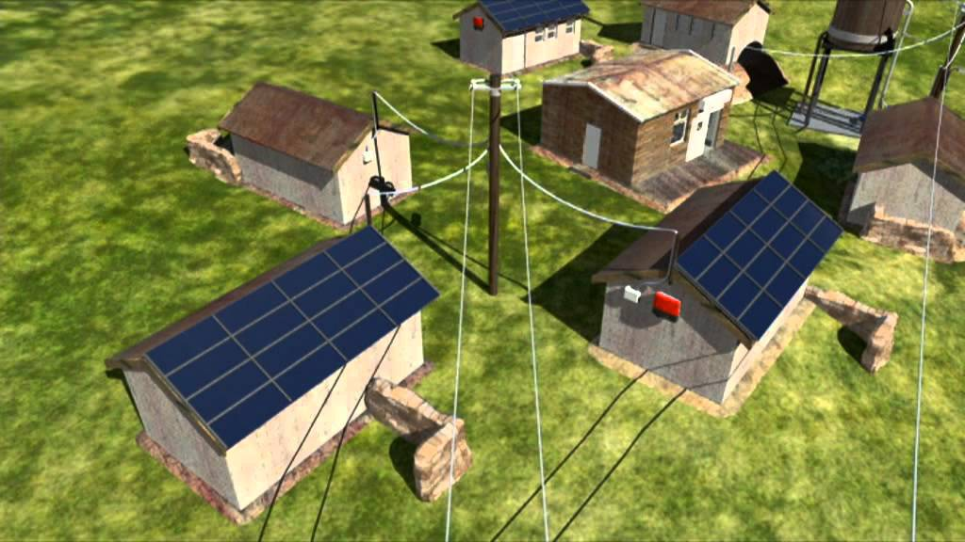
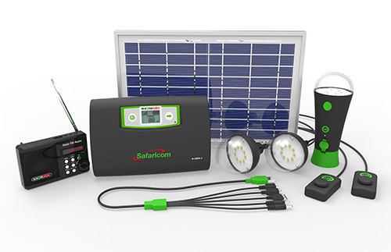
$420 BILLION FOR MINI-GRID AND OFF-GRID ELECTRIFICATION BY 2030
Mini-grids
Isolated off-grid
Sources: IEA estimate, M-Kopa

Slide 3
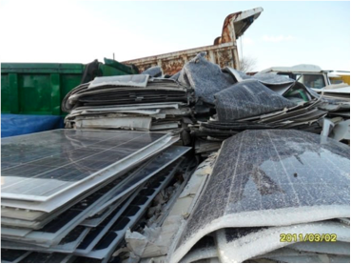
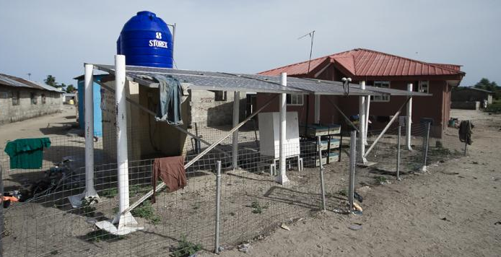
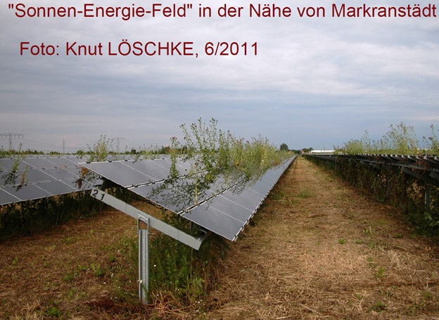
“SET IT AND FORGET IT” HAS PLAGUED MANY PAST NGO AND GOVERNMENT EFFORTS…
…LEADING TO A LACK OF TRUST

Slide 4
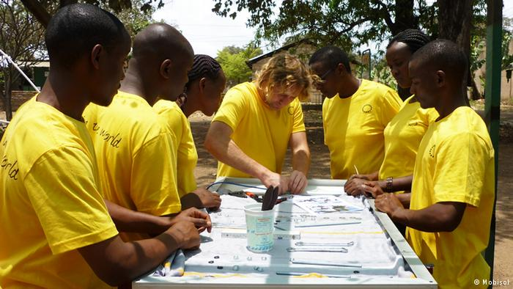
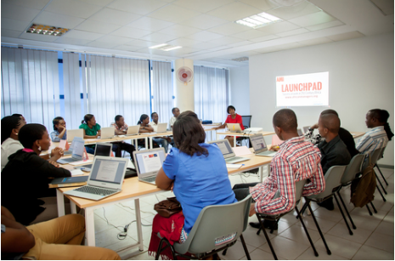
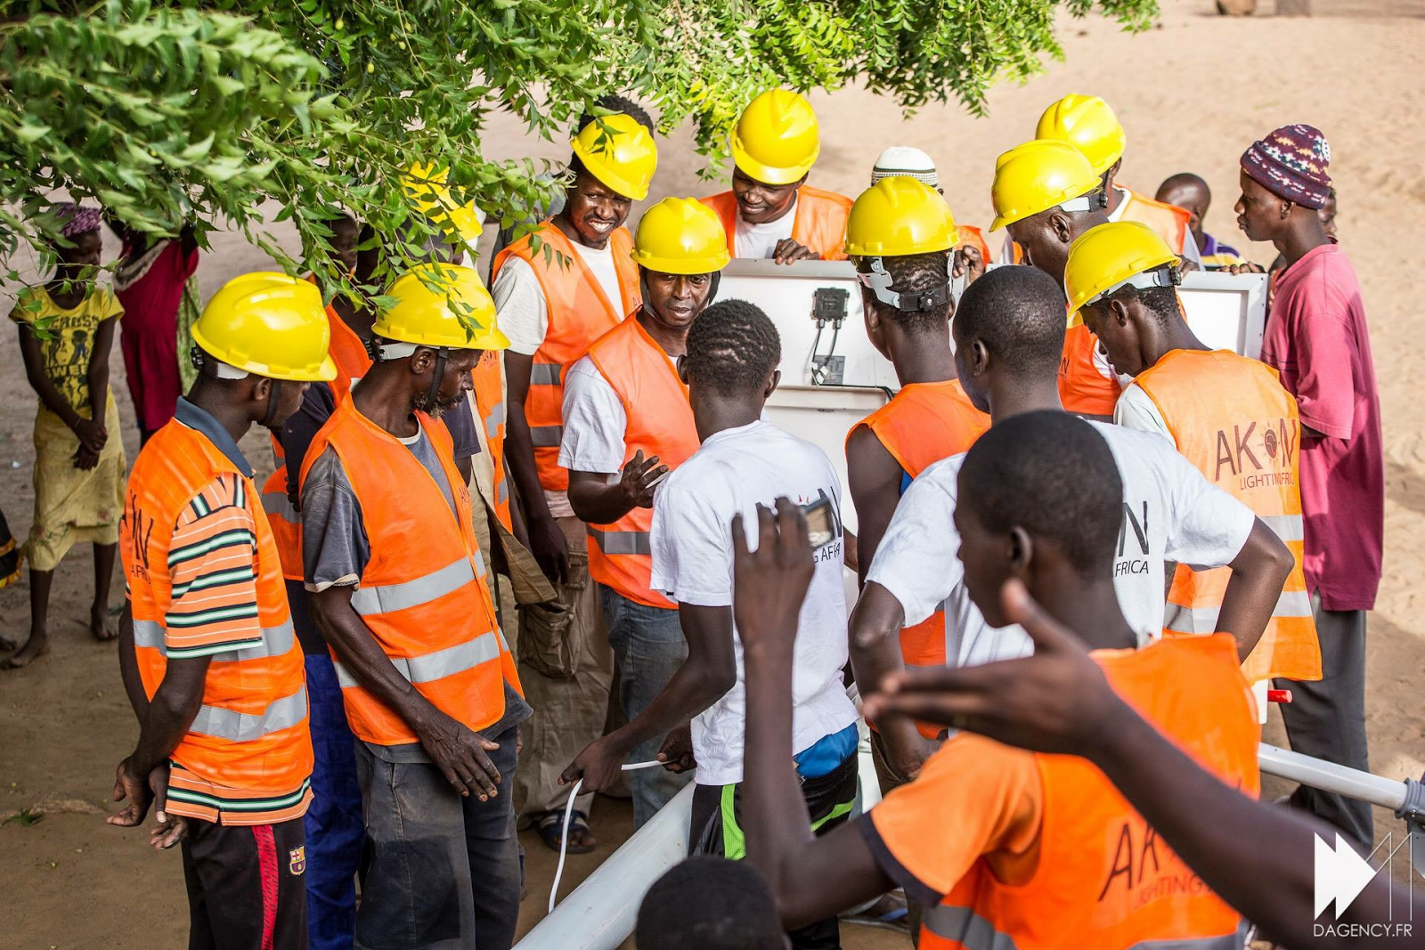
LOCAL TRAINING

Slide 5
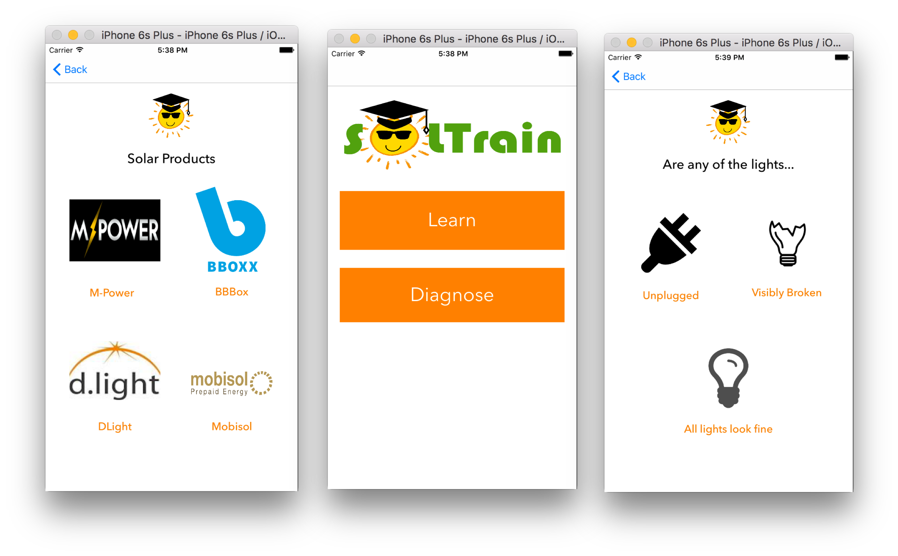
MOBILE TRAINING AND DIAGNOSTIC PLATFORM

Slide 6
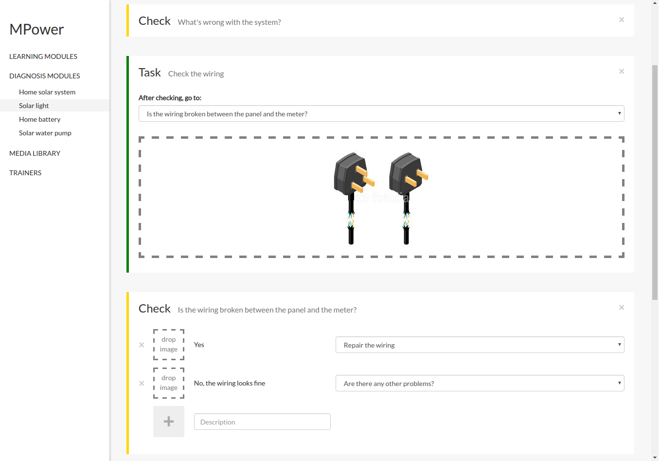
COMPANY-SPECIFIC CONTENT
DEVELOPMENT PLATFORM

Slide 7

Thank you!

